Slide 1

Slide 1
Intelligence Analytics Challenge v4.0
Team HackAnalytics
Priyanshu Sharma Priyash Maini
Kanak Kanti Roy Shubham Kothari

Slide 2
Problem Statement
Forecasting box-office performance is one of the most important decisions that production houses and movie distributors are involved in before getting involved in a project. The U.S. is the third largest film market in the world in terms of tickets sold per year, ranking behind China and India.
We leverage our Analytics skills to forecast box-office performance of movies and identify key factors that impact the performance.

Slide 3
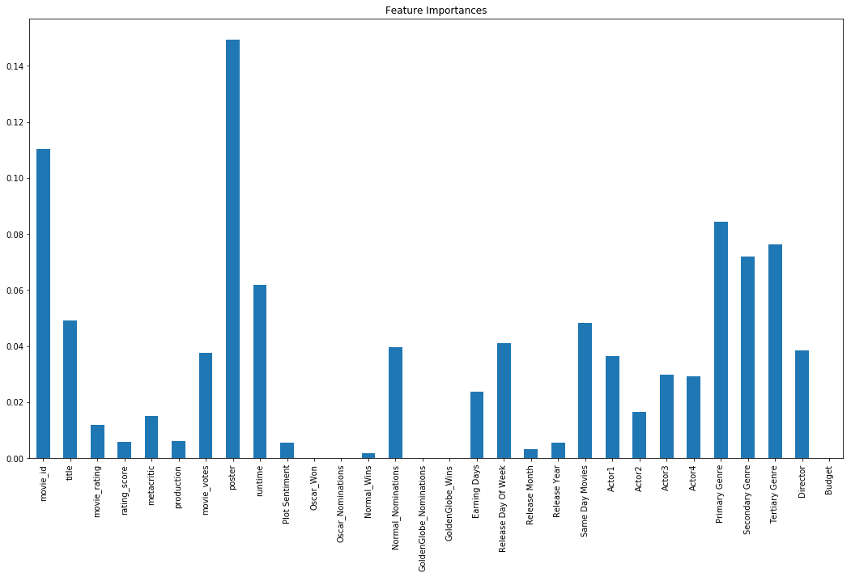
Slide 2
Why do some small budget films become blockbuster hits?
Alternatively, why do some large budget films fail?
After carefully analyzing the factors that impact the Box-Office performance of a movie, it is evident that Budget of a movie has little to no impact on the box-office collection.
We can say that how people/audience reacts to the Poster, Director, Actor, and Genre is definitely more important than the budget of Movie.
Thus, we can corroborate the fact that sometimes a small-budget movie can become a blockbuster if it has a really popular Director or Genre compared to a large-budget movie with unpopular Director or Genre.
2

Slide 4
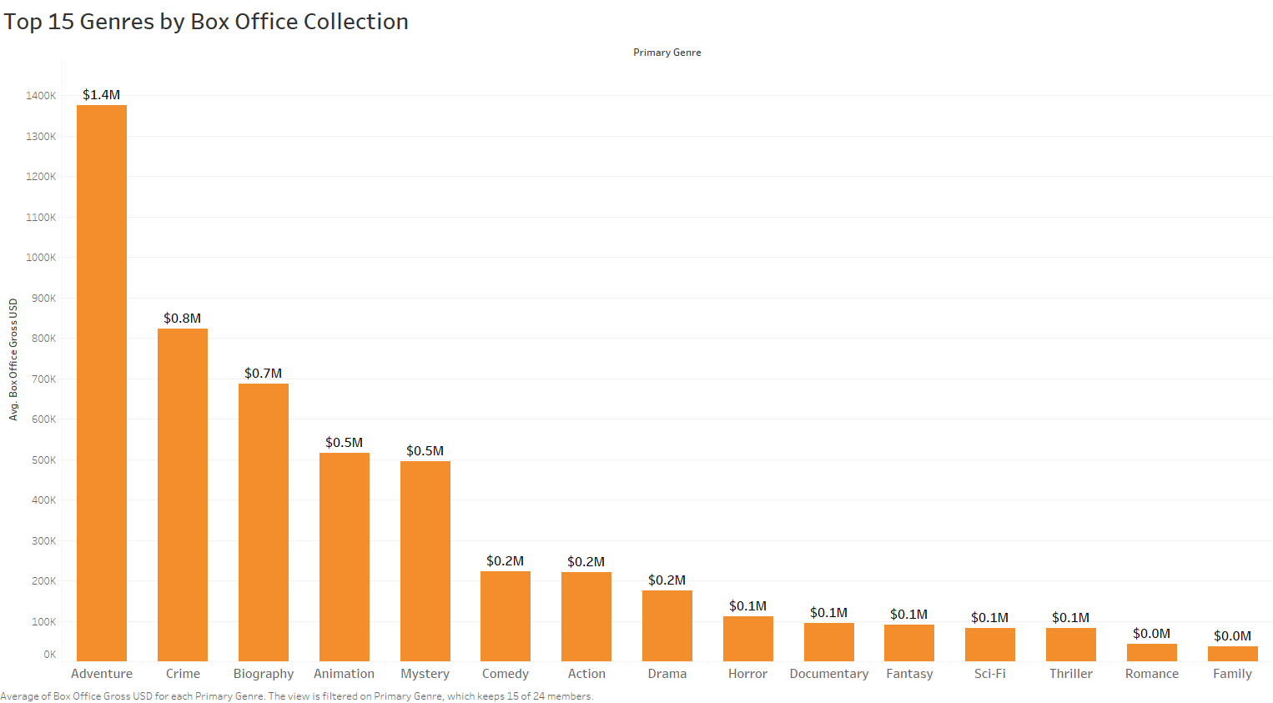
Slide 2
How do movies fare in terms of genre?
Comedy, science fiction?
After carefully analyzing the factors that impact the Box-Office performance of a movie, we can see in the chart that the top 5 Genres with highest Average of box-office collections for movies are:
Adventure
Crime
Biography
Animation
Mystery
2

Slide 5
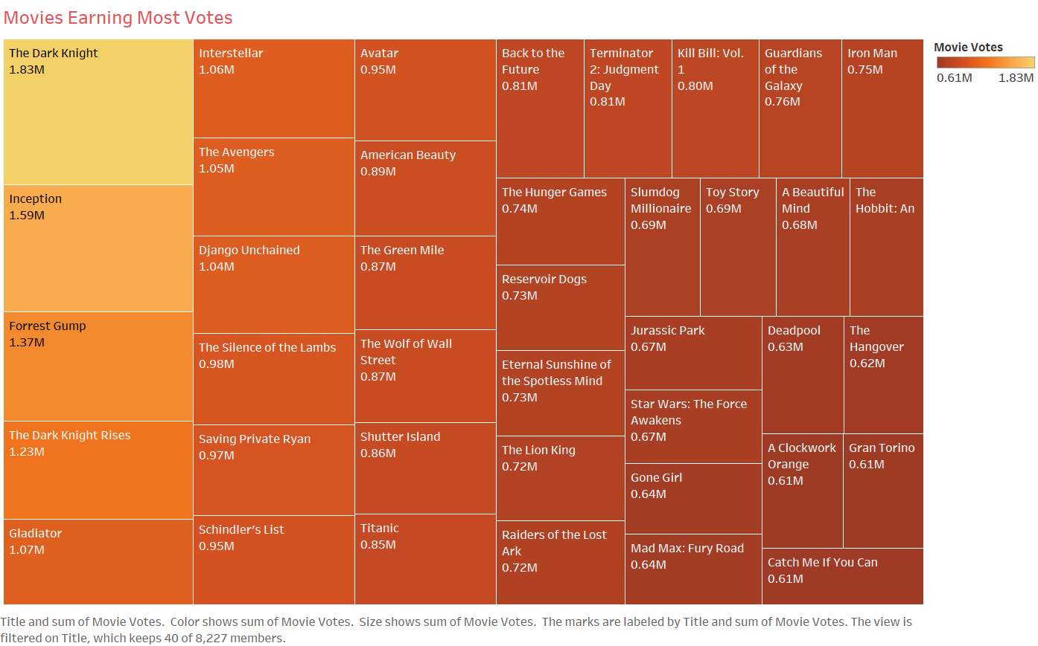
Slide 2
How well do you think that remakes,
tent-poles and sequels perform?
Remakes and sequels definitely do better in terms of box-office collections and ratings if the previous movies of that series have done better.
We can see that the performance of remakes/sequels depend a lot on the performances of their earlier versions/parts.
Example:
The Dark Knight
The Dark Knight Rises
2

Slide 6
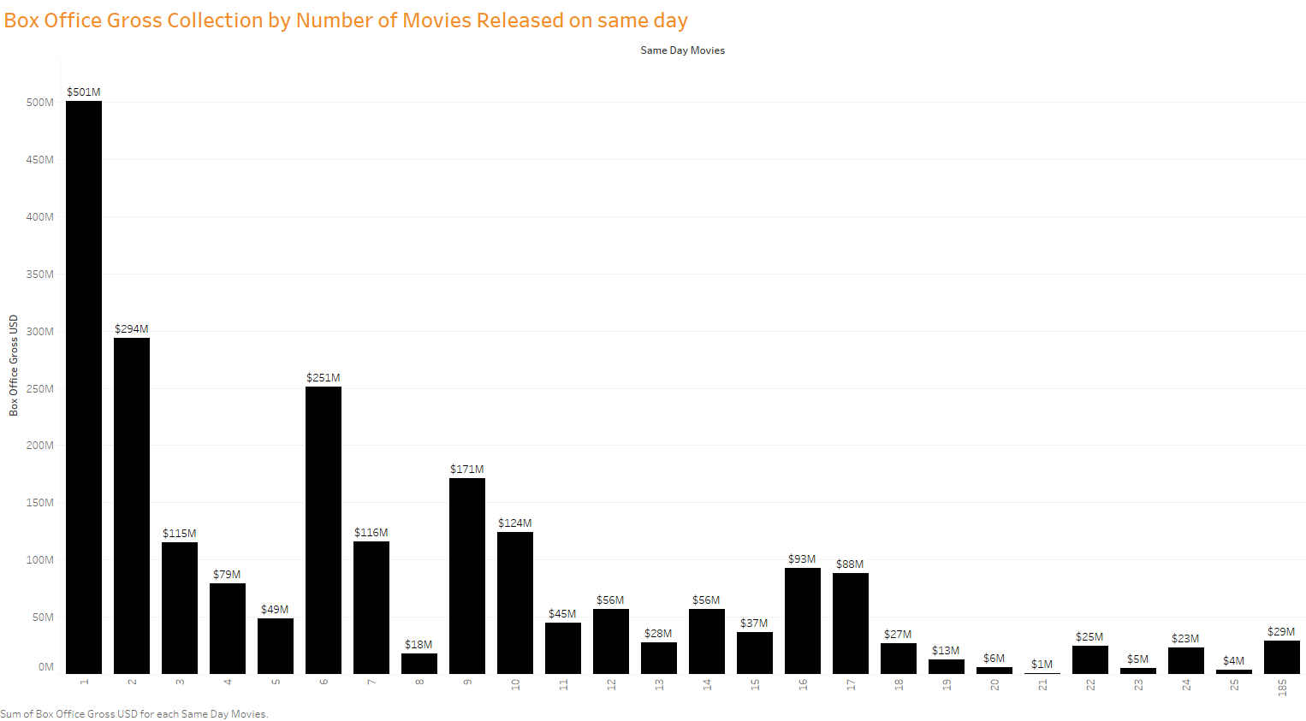
Slide 2
Does release date influence box office performance?
Do movies released at the same time perform differently?
Release date has a lot of impact on the box office performance of movies.
Movies released in the month of November and September have done most gross collections in the box-office.
Similarly, most of the movies are released on Friday, and hence definitely impact the box-office performance.
Movies released on the same day tend to compete each other for box-office gross collection as is evident from the chart.
If only one movie is released on a particular day, then it has higher box-office earnings as it has no competition.
2

Slide 7
Slide 2
Key Variables impacting Profitability of a Movie
From the predictive model built, we can say that there are several factors impacting the profitability of a movie, likely:-
Director making a movie
Actors performing in a movie
Primary Genre of a movie.
Movie Length (Runtime)
Same Day Movies or not
Release Day Of Week, Release Month etc.
We created a robust machine learning model to accurately predict Gross Box office taking all the relevant features with a R-squared of 78.5% and a RMSE of 1.5, which helped us to unfold the key variables impacting the profitability of a movie.
2

Slide 8
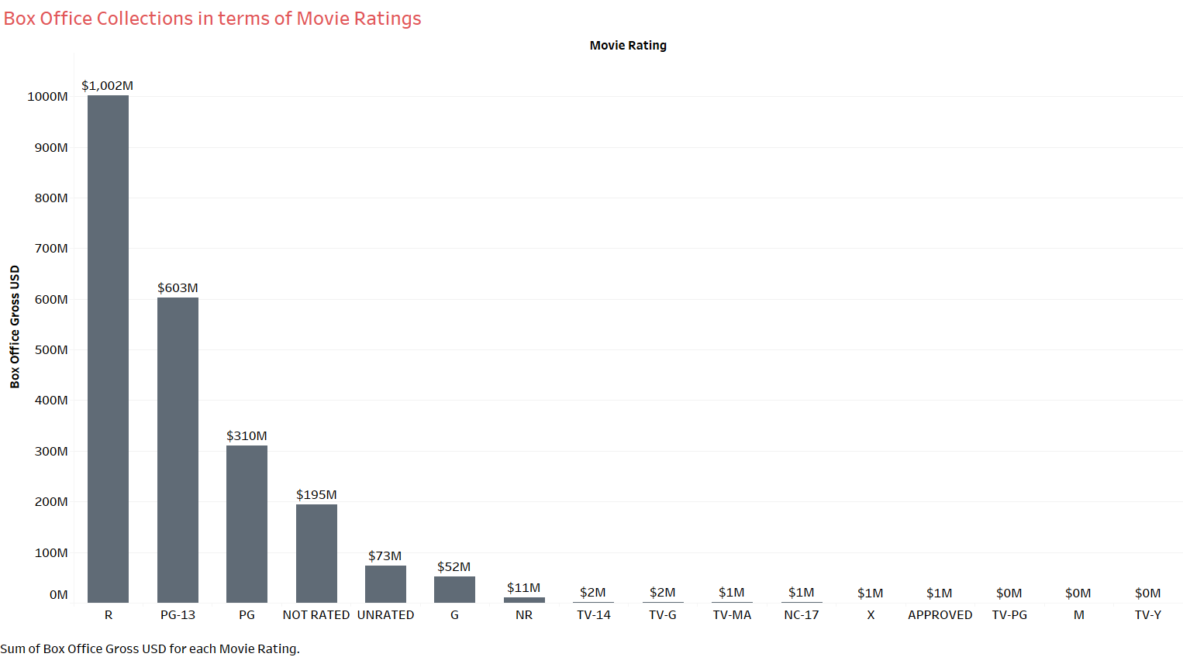
Slide 2
Does rating of a movie have any effect on movie earnings?
Rating of a movie has significant effect on movie earnings.
Our analysis shows that Movies with rating R have high box-office collections of $1,002M.
Movies rates PG-13 account for $603M in the box-office and are 2nd followed by PG,NOT RATED and UNRATED.
2

Slide 9
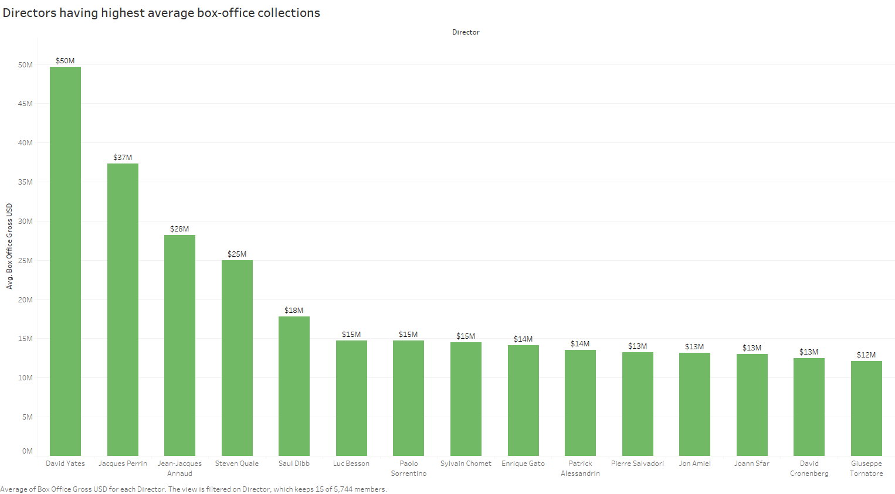
Slide 2
If you are running a movie production house, which
Actor(s)/Director would you like to cast in your movie?
If we were running a movie production house, it is more profitable to work with directors like David Yates and Jacques Perrin as they have highest average gross box-office.
Similarly, it would be profitable to have Emma Watson or Richard Griffiths to cast in our movie as it would give us more collections in box-office.
2

Slide 10
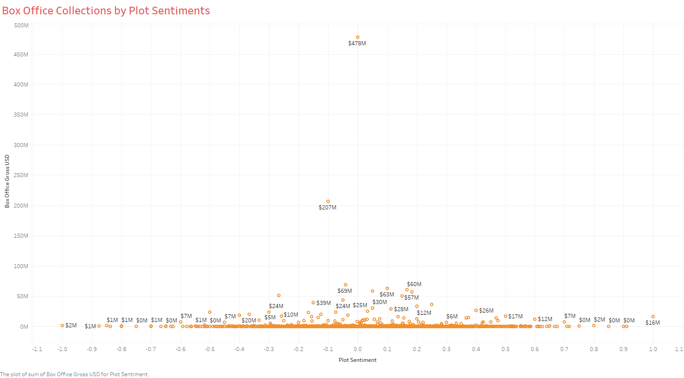
Slide 2
Does a plot of a movie affect its earnings in any way?
We collected the plot sentiments from the plots provided and on analysis we found that plots do impact the movie earnings.
Plots that tend to carry neutral sentiments tend to make more in the box-office than the ones with extreme positive or negative sentiments.
2

Slide 11
Slide 2
Key Highlights of our Analysis
Some of the most important factors that we considered and kept in our mind during the end-to-end process of this analysis are:
Time Value of Money: It is obvious that a gross collection of $100K of a movie released in 1969 should be considered better than a movie that released in 2017 and collected the same amount.
Currency Conversions: The gross collections and budgets were mentioned in different currencies but we managed to convert them into US dollars to make a common ground for comparison and analysis.
Plot Sentiments: Yes, plot of a movie is definitely a very important factor that contributes to its success and we successfully extracted the polarity of sentiments conveyed in the plots to better analyze the data.
Awards and Nominations: Due to the type of data, it was difficult to manipulate it into a way that we can leverage the nominations and various categories of awards separately.
Results: We successfully developed a predictive model after all the data cleaning and wrangling that was so accurate that total Root Mean Squared Error was 1.5 and the model was able to explain nearly 78.5% variations in Gross Collections.
2

Slide 12

Slide 11
THANK YOU

